Slide 1
Predicting resignation rates in the ICT industry and trend analysis for ICT higher education intakes
Muhammad Iylia
P7474841
NSDDA1/CE/2220/4

Slide 2
Datasets
Job Vacancy Rates
Recruitment Rates
Resignation Rates
Paid Overtime Hours
Total Paid Hours
Incidence of Retrenchment
Polytechnic Intake
University Intake

Slide 3
Datasets
Filtered to Information, Communications and Technology industry data
Data with quarter column was split into year and quarter columns using pd.str.split()
Data was merged using inner join by year and/or quarter columns using pd.join()
‘-’ values were converted to 0

Slide 4
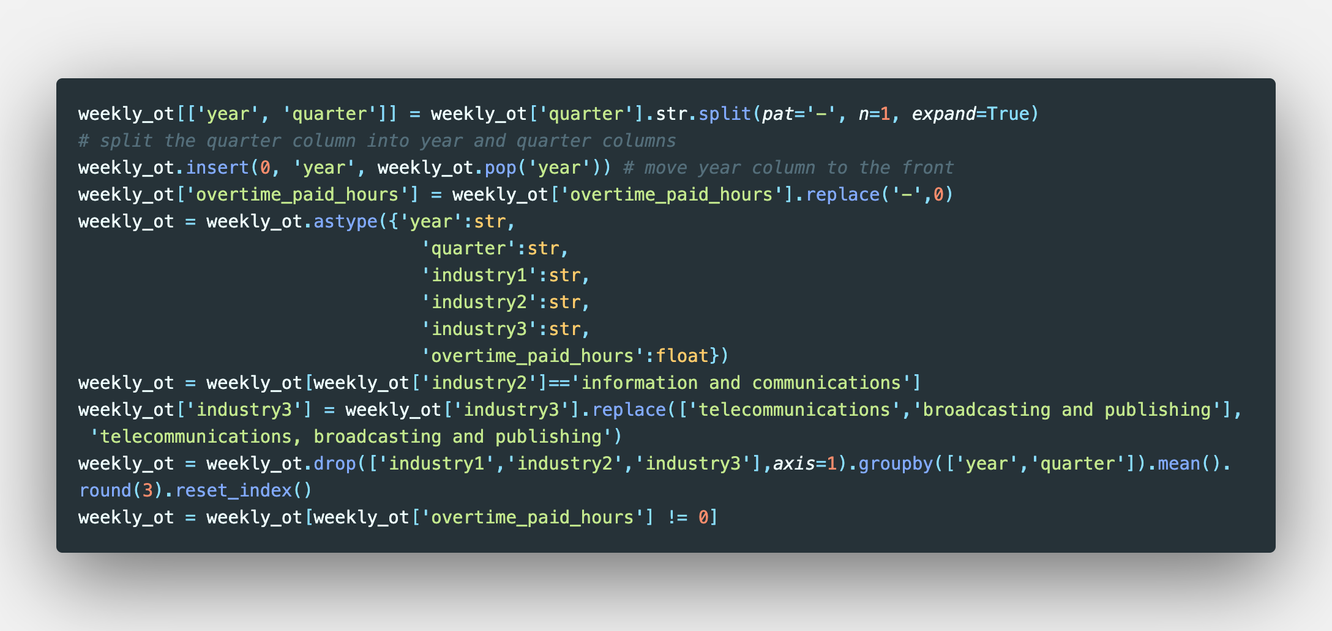
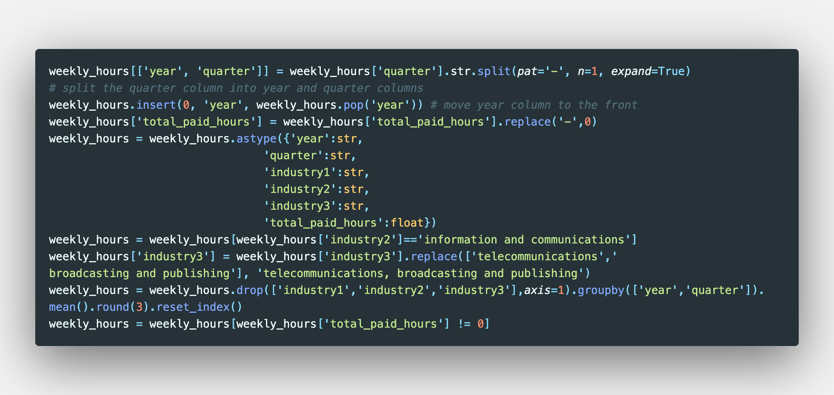
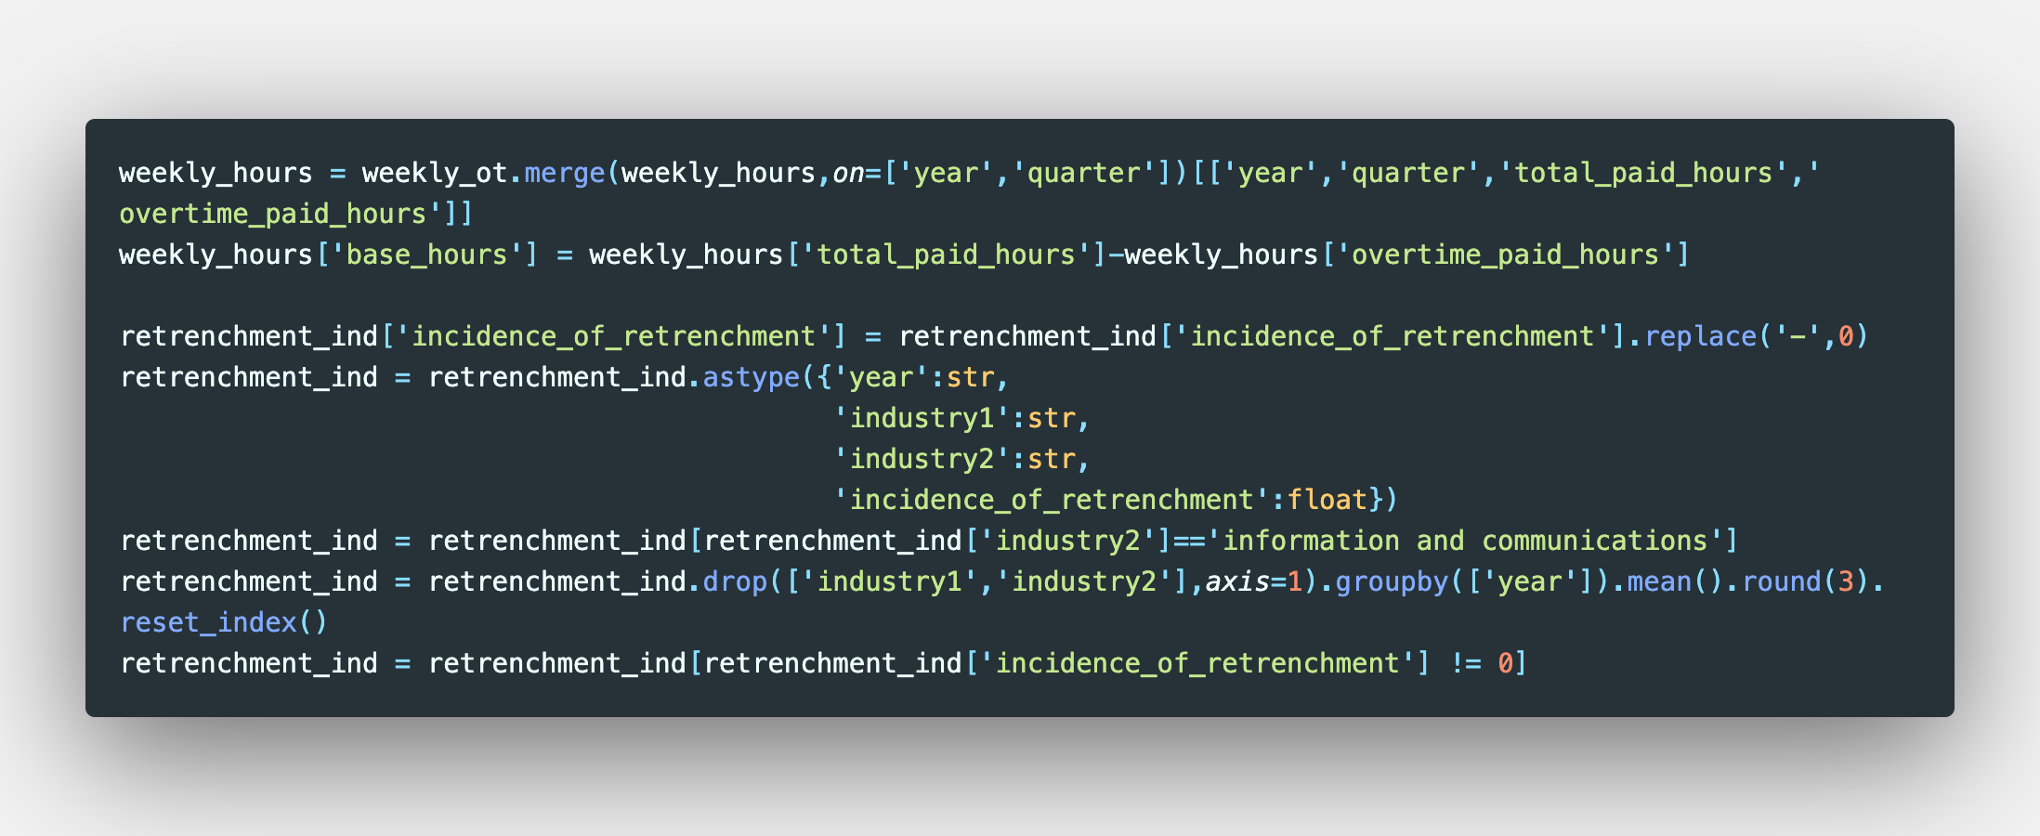
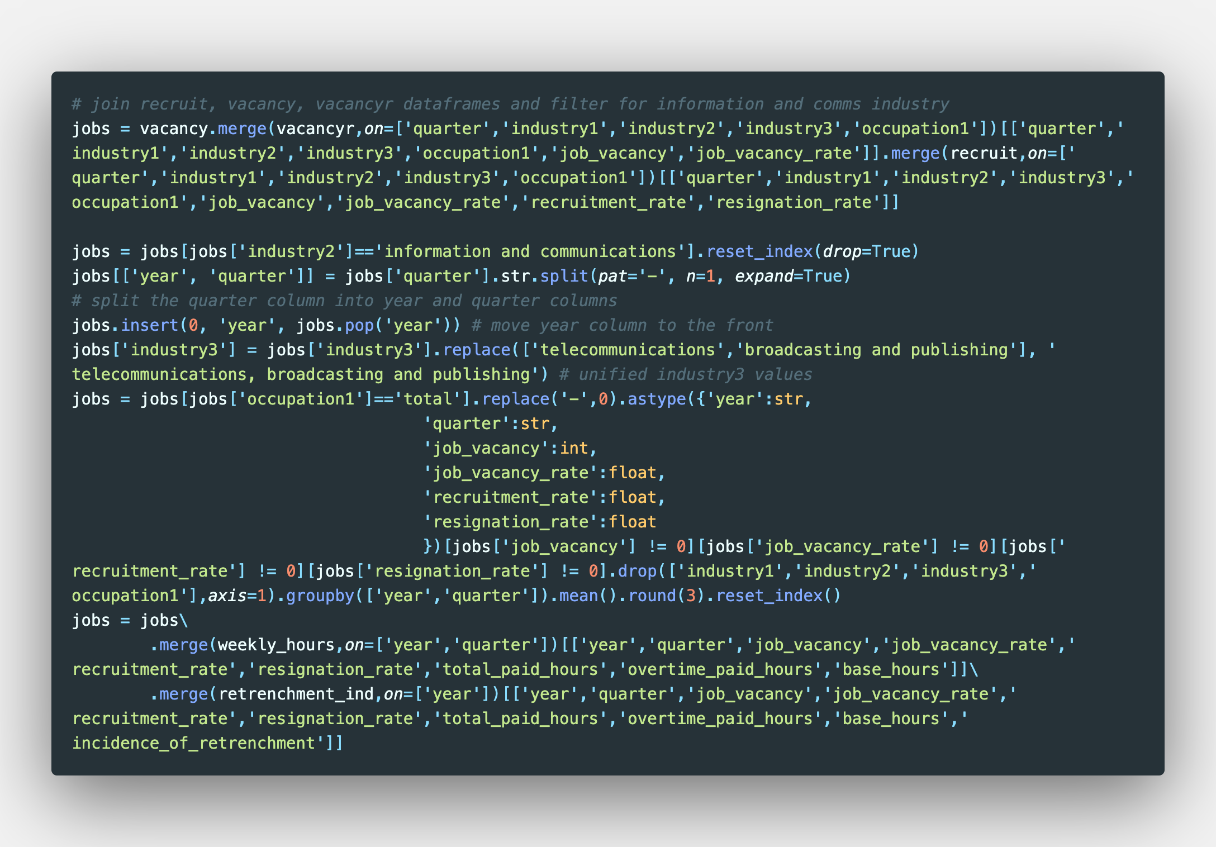
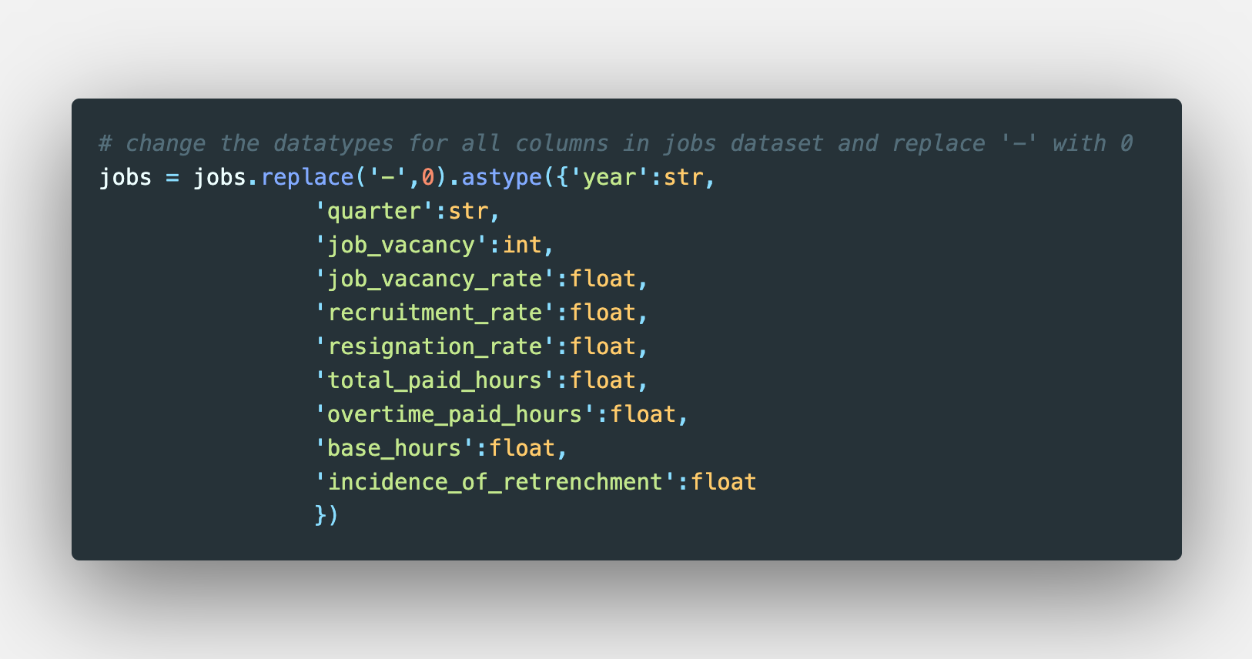
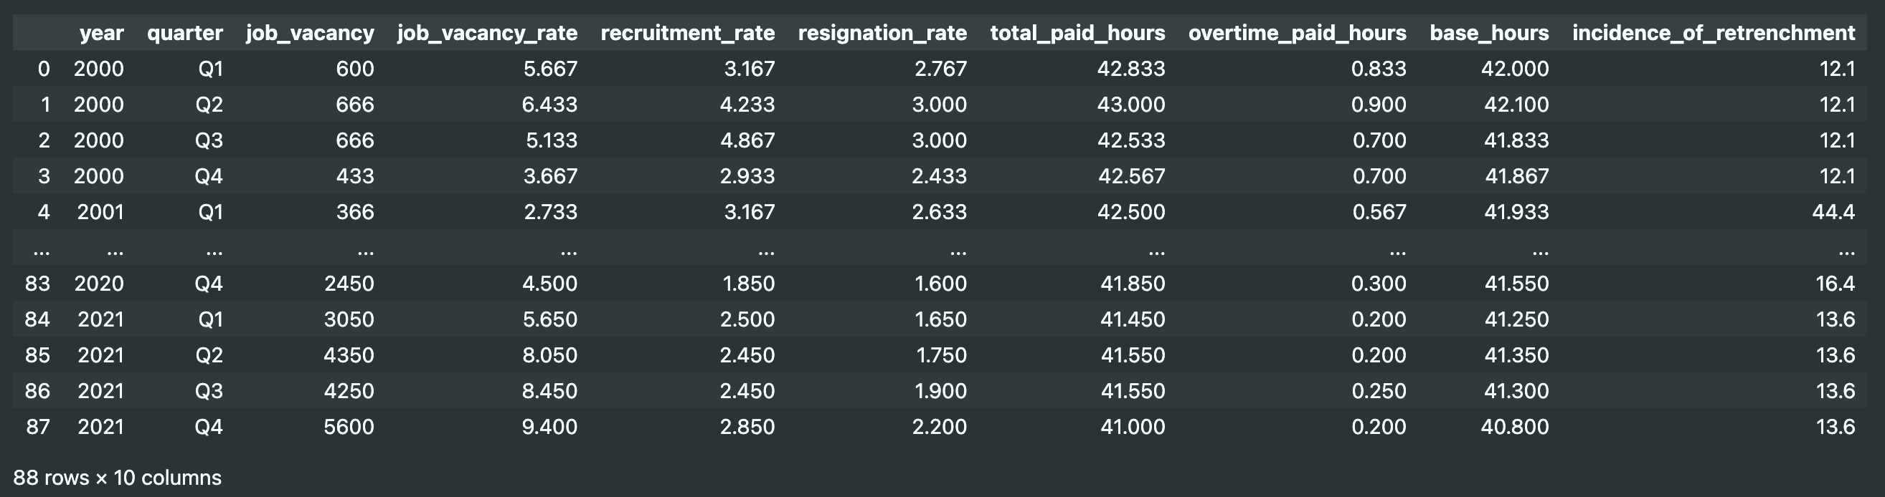
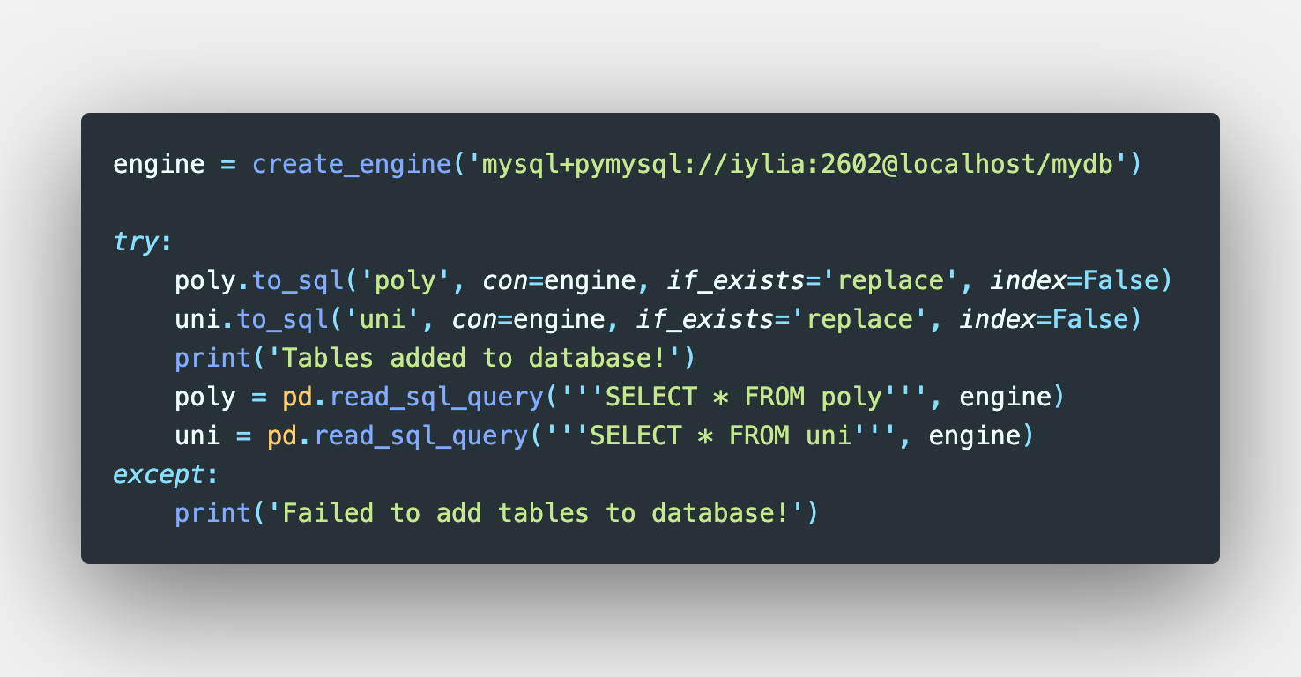
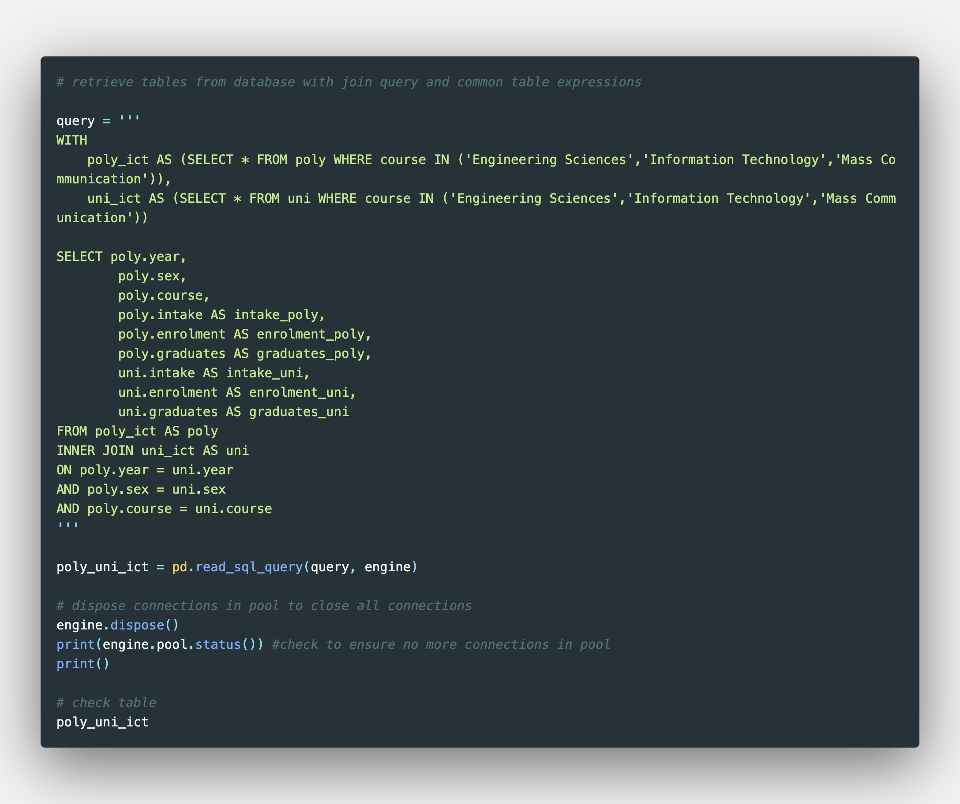
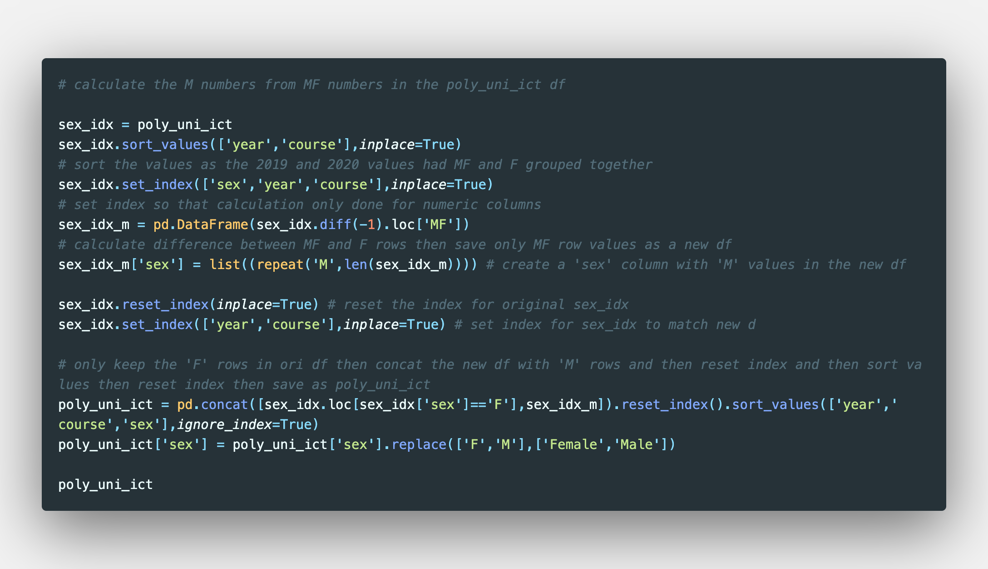
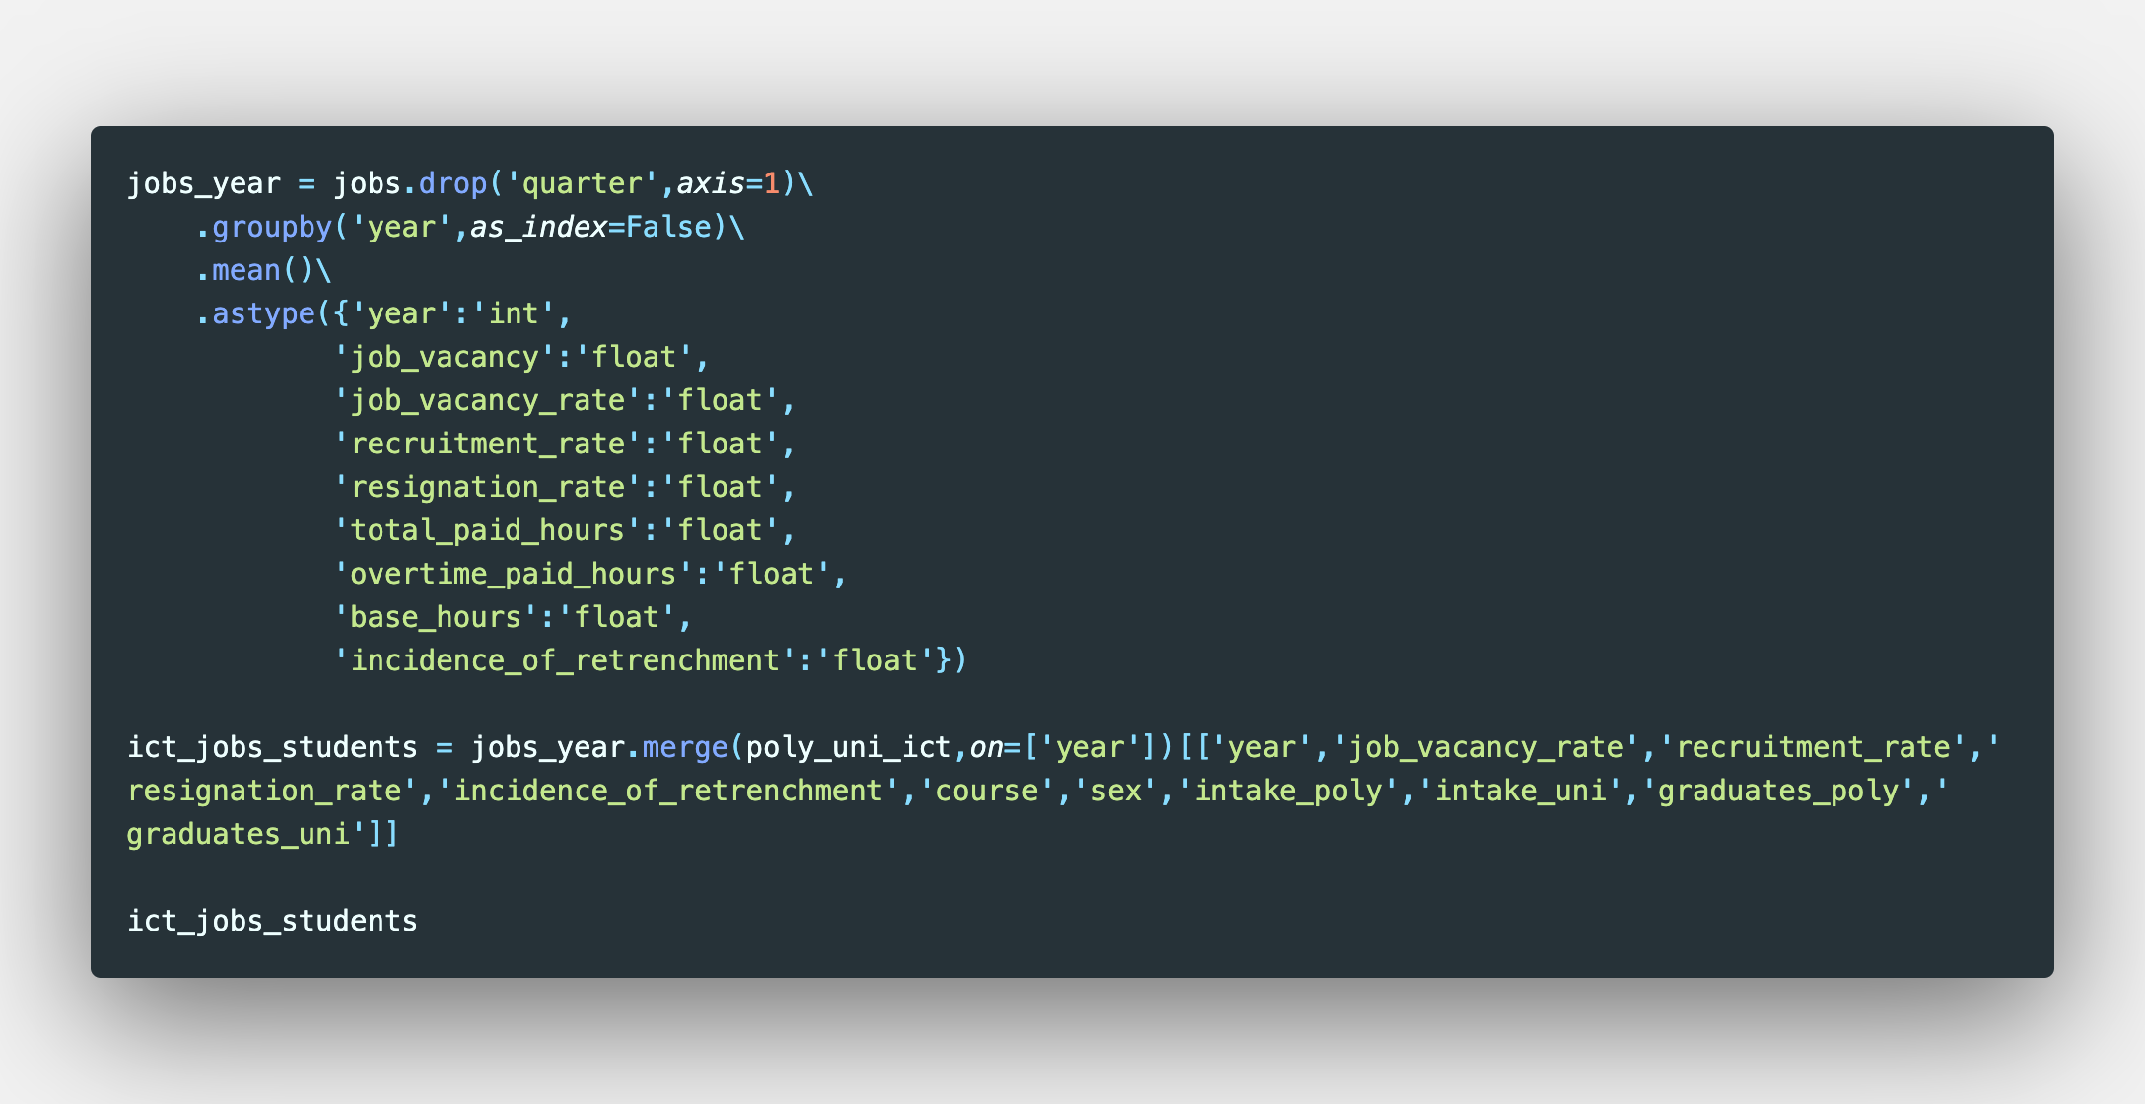
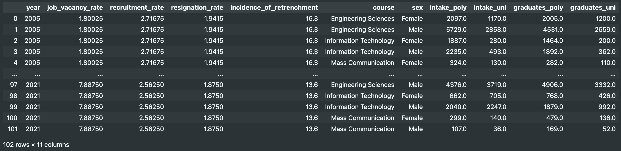
Datasets

Slide 5
Datasets

Slide 6
Datasets

Slide 7
Datasets

Slide 8
Datasets

Slide 9
Datasets

Slide 10
Datasets

Slide 11
Datasets

Slide 12
Datasets

Slide 13
Datasets

Slide 14
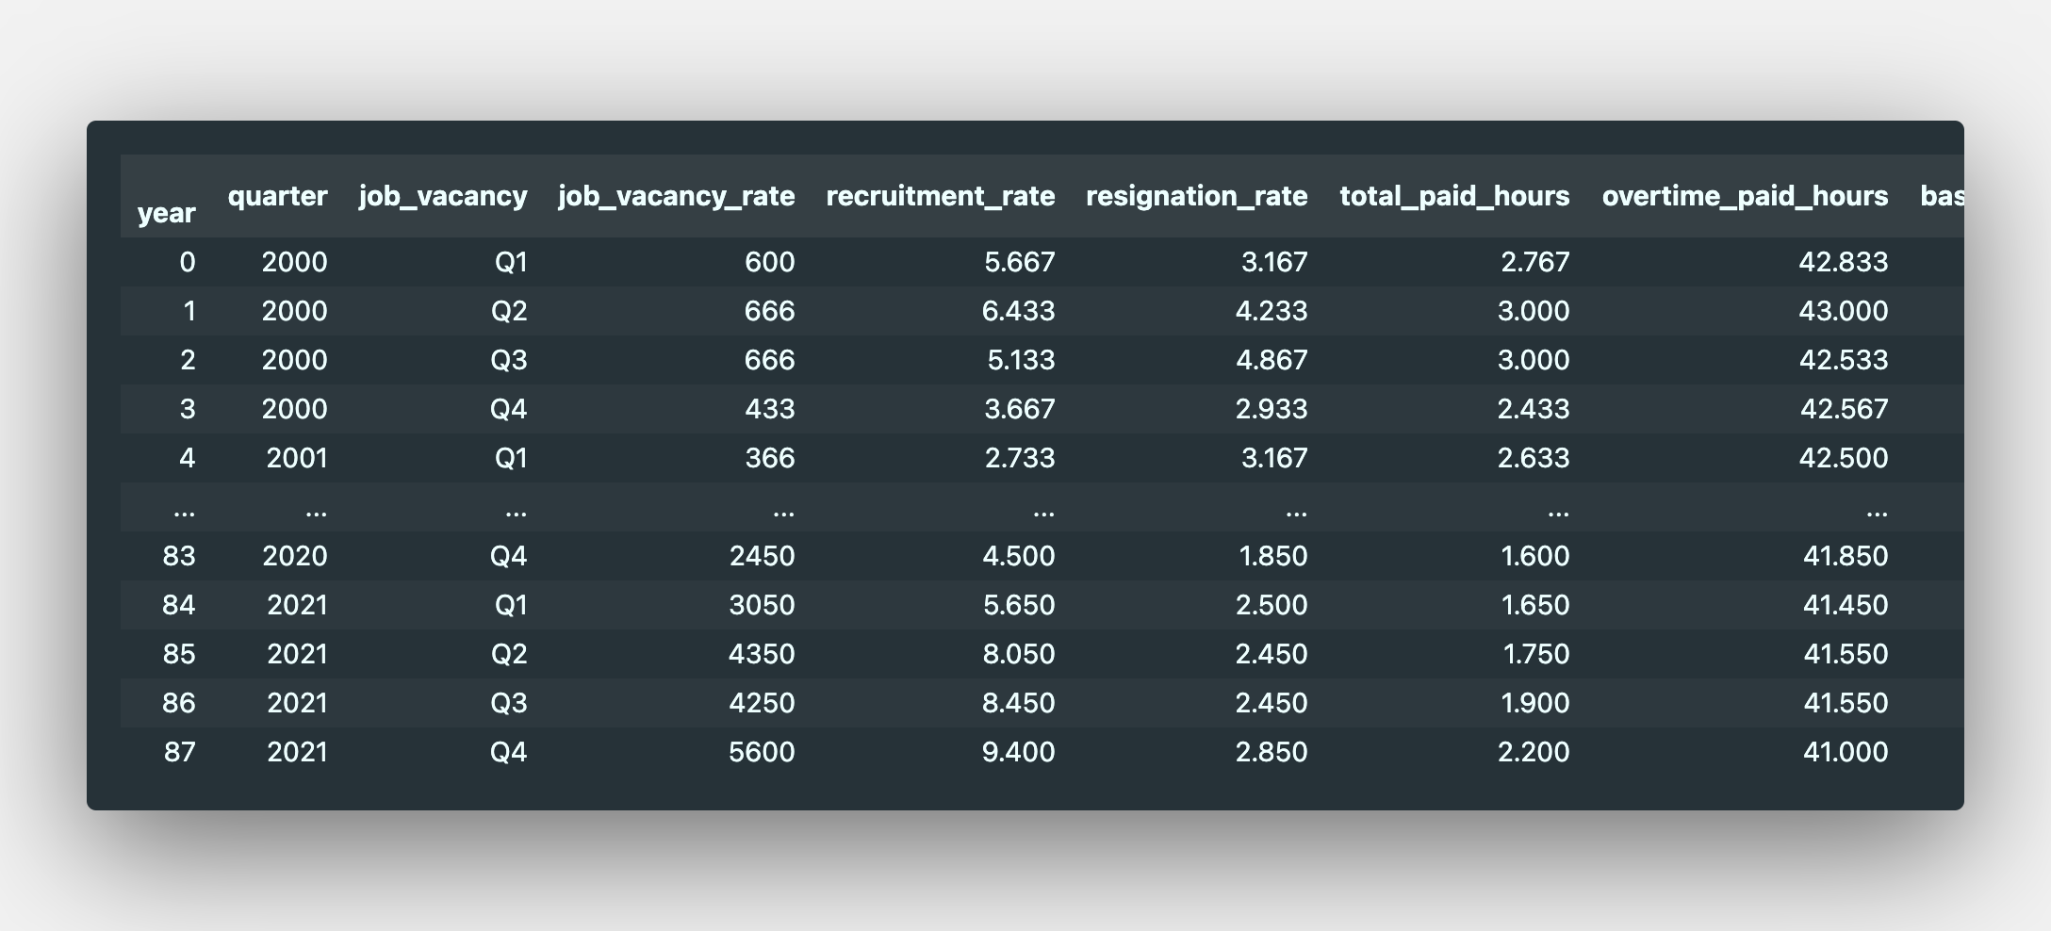
Datasets

Slide 15
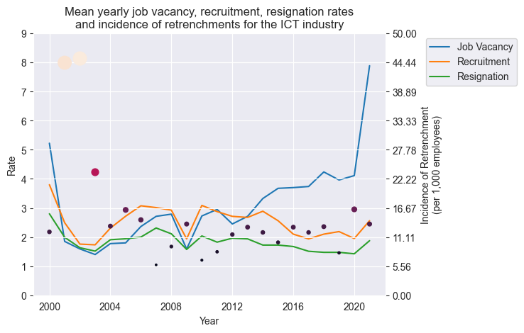
Mean yearly jobs data in the ICT industry
Incidences of retrenchments were seen to follow cyclical economic patterns
Post-crisis recovery also saw periods of increased vacancies with relatively stable recruitment and resignation rates

Slide 16
Tests of normality
Komolgorov-Smirnov test for samples larger than 50
Histogram plot
Q-Q plot
Variables of interest:
Job vacancy rate
Recruitment rate
Resignation rate

Slide 17
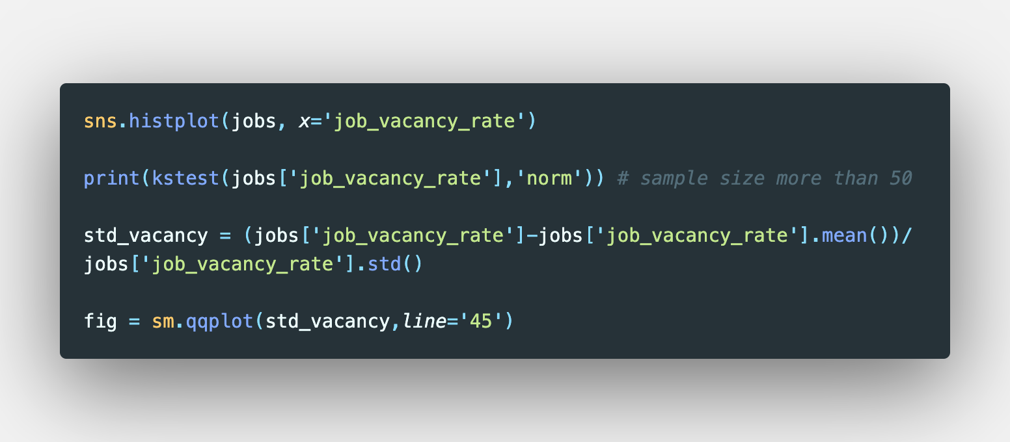
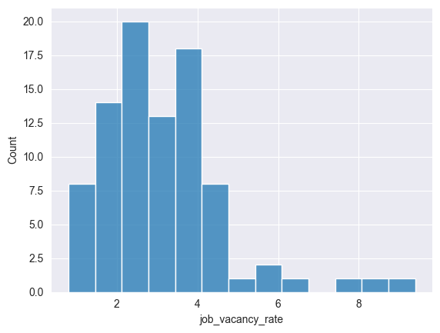
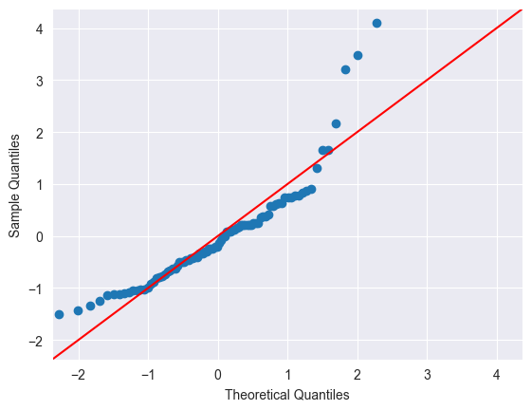
Job Vacancy Rate
Komolgorov-Smirnov Test (𝛼 = 0.05):
Statistic = 0.8687
p-value = 6.17
The data is non-normal based on the histogram distribution and Q-Q plots, despite rejecting the null hypothesis in the K-S test.

Slide 18
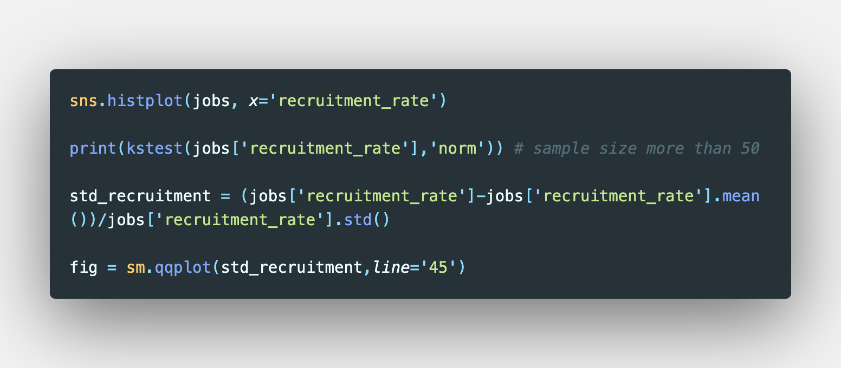
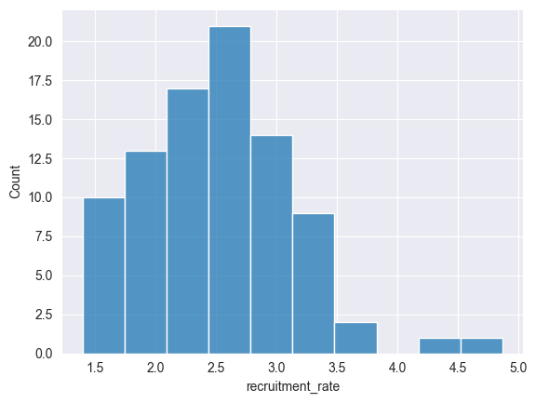
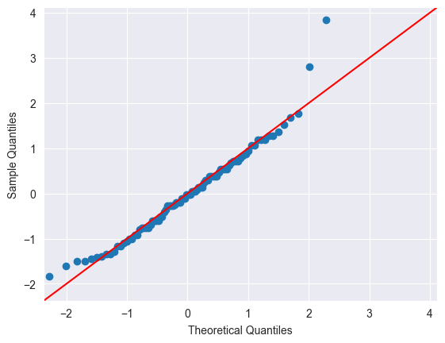
Recruitment Rate
Komolgorov-Smirnov Test (𝛼 = 0.05):
Statistic = 0.9260
p-value = 6.23
The data is normal based on the histogram distribution and Q-Q plots and rejecting the null hypothesis in the K-S test.
However, data is right-skewed.

Slide 19

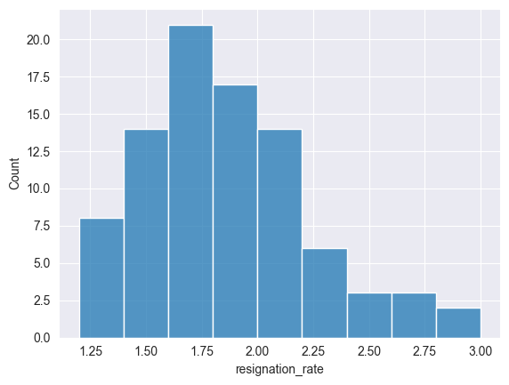
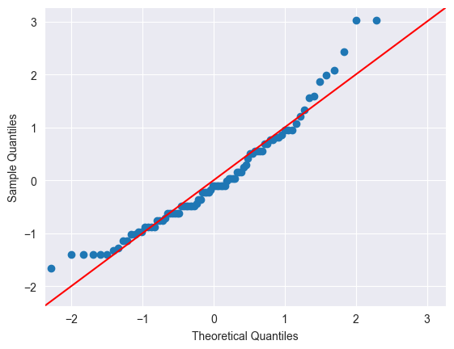
Resignation Rate
Komolgorov-Smirnov Test (𝛼 = 0.05):
Statistic = 0.8918
p-value = 2.09
The data is normal based on the histogram distribution and Q-Q plots and rejecting the null hypothesis in the K-S test.
However, data is right-skewed.

Slide 20
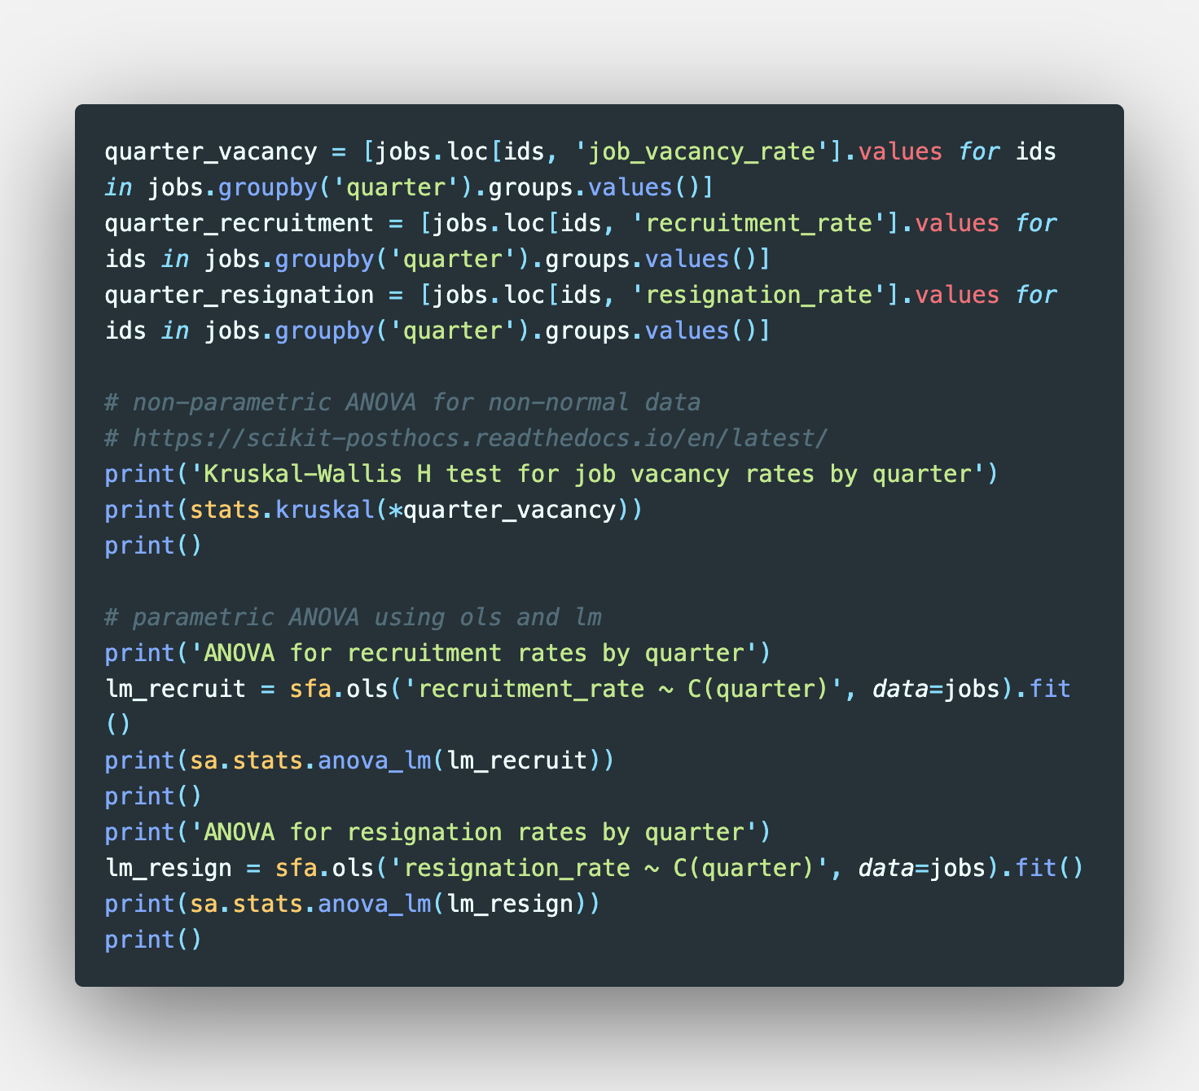
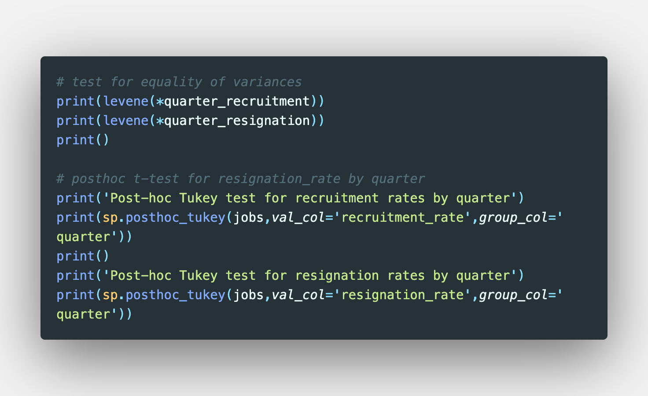
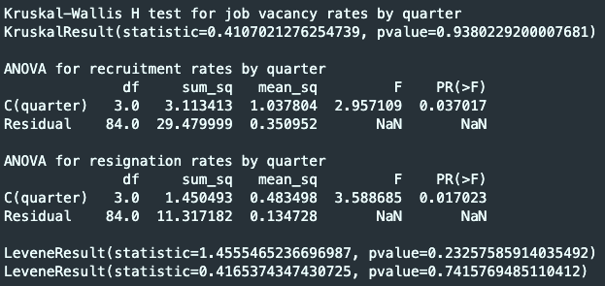
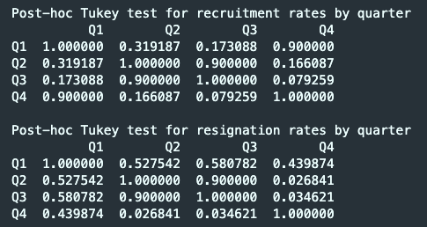
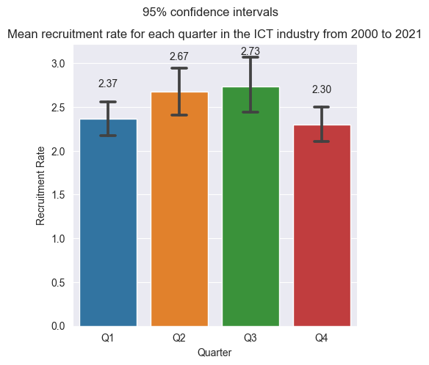
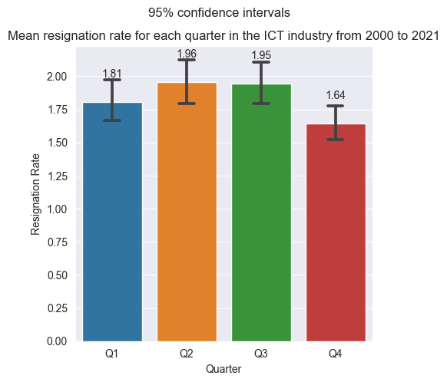
ANOVA tests for quarterly averages of job vacancy, recruitment and resignation rates

Slide 21
ANOVA tests for quarterly averages of job vacancy, recruitment and resignation rates

Slide 22
ANOVA tests for quarterly averages of job vacancy, recruitment and resignation rates

Slide 23
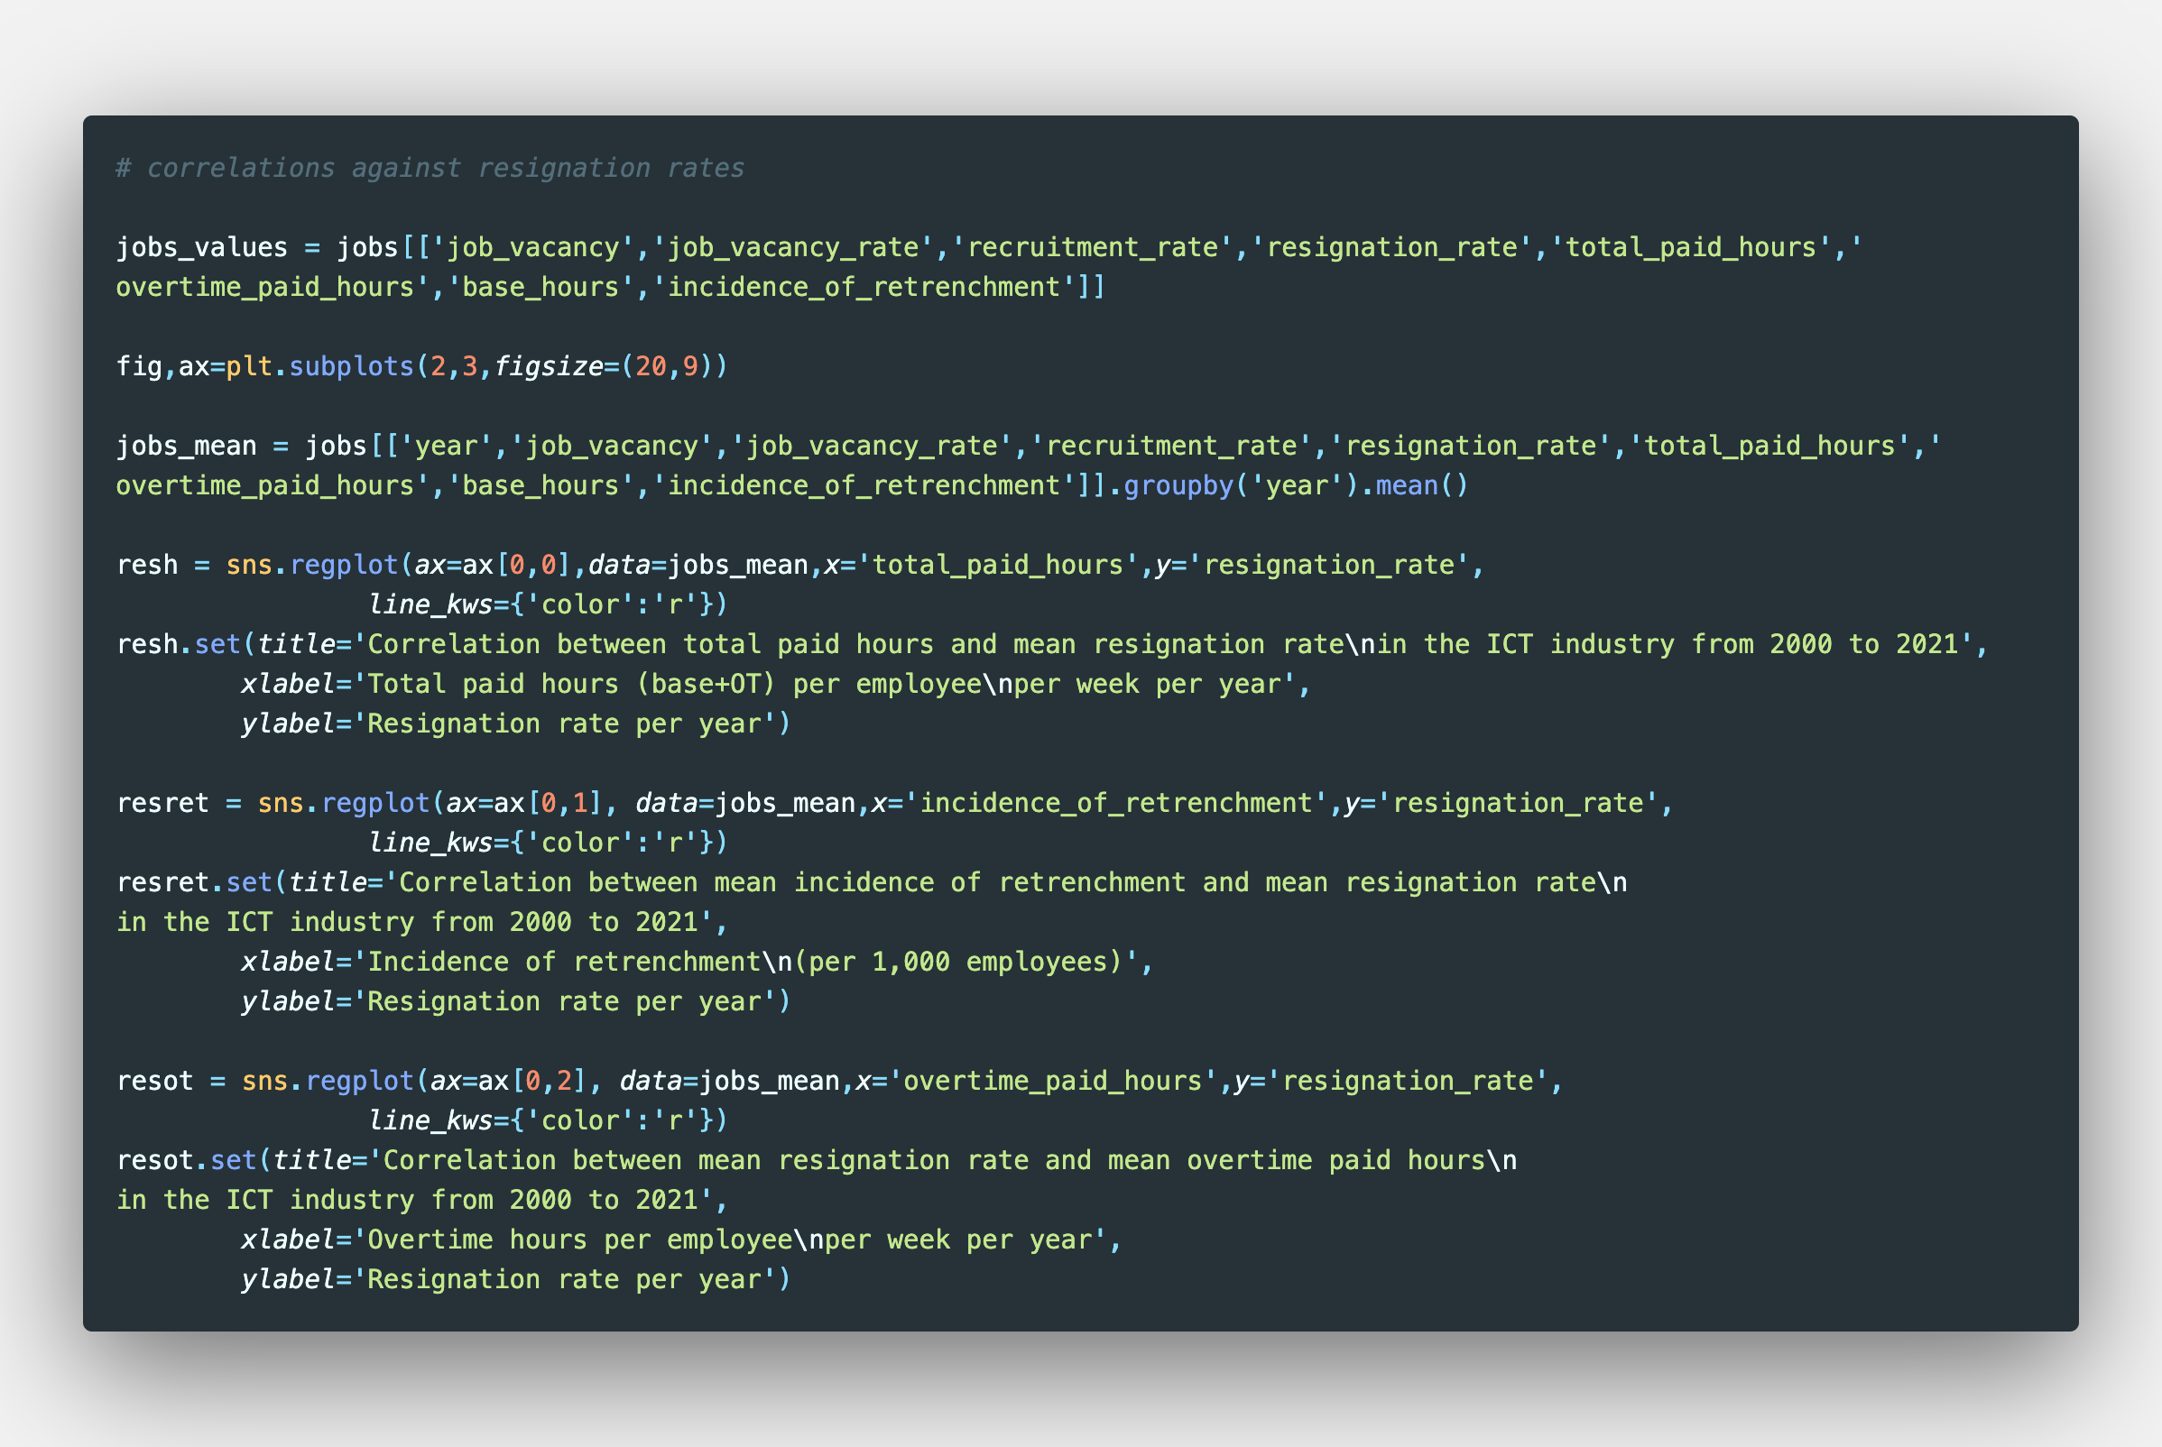
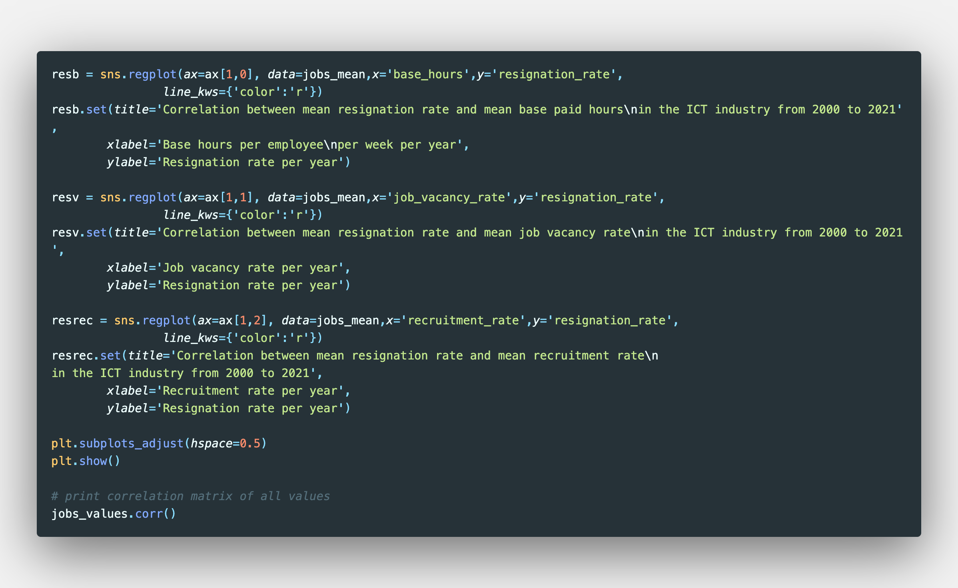
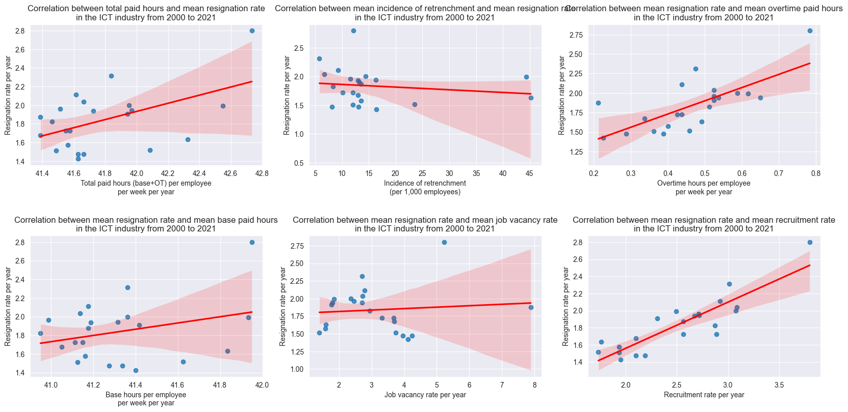
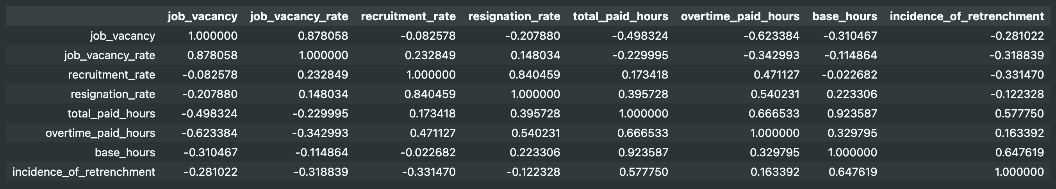
Correlation of variables with resignation rates

Slide 24
Correlation of variables with resignation rates

Slide 25
Correlation of variables with resignation rates

Slide 26
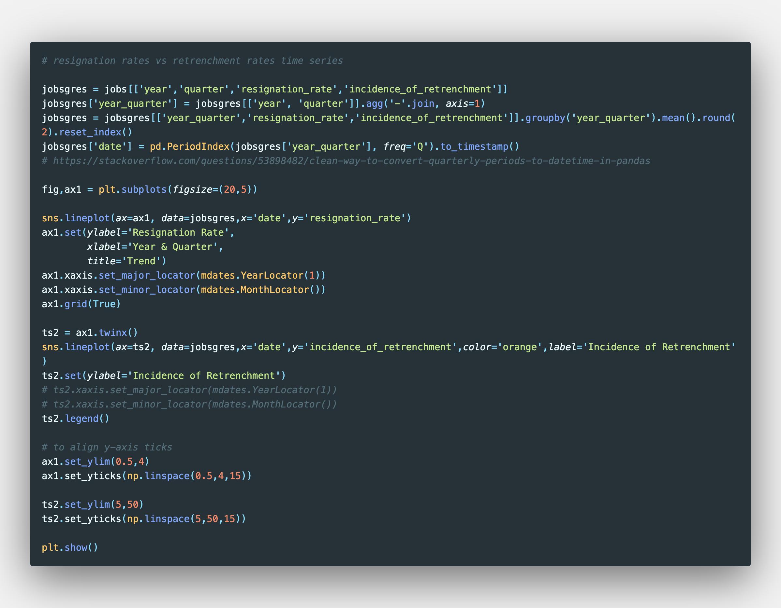
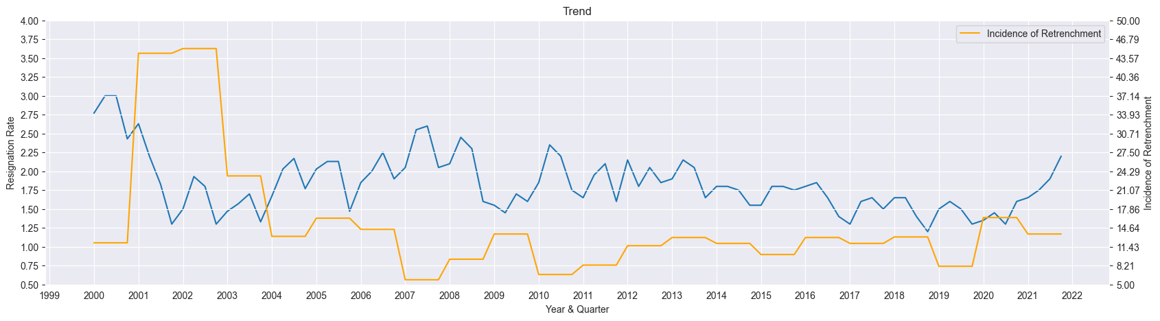
Time series analysis of Incidence of Retrenchment and Resignation Rates

Slide 27
Time series analysis of Incidence of Retrenchment and Resignation Rates

Slide 28
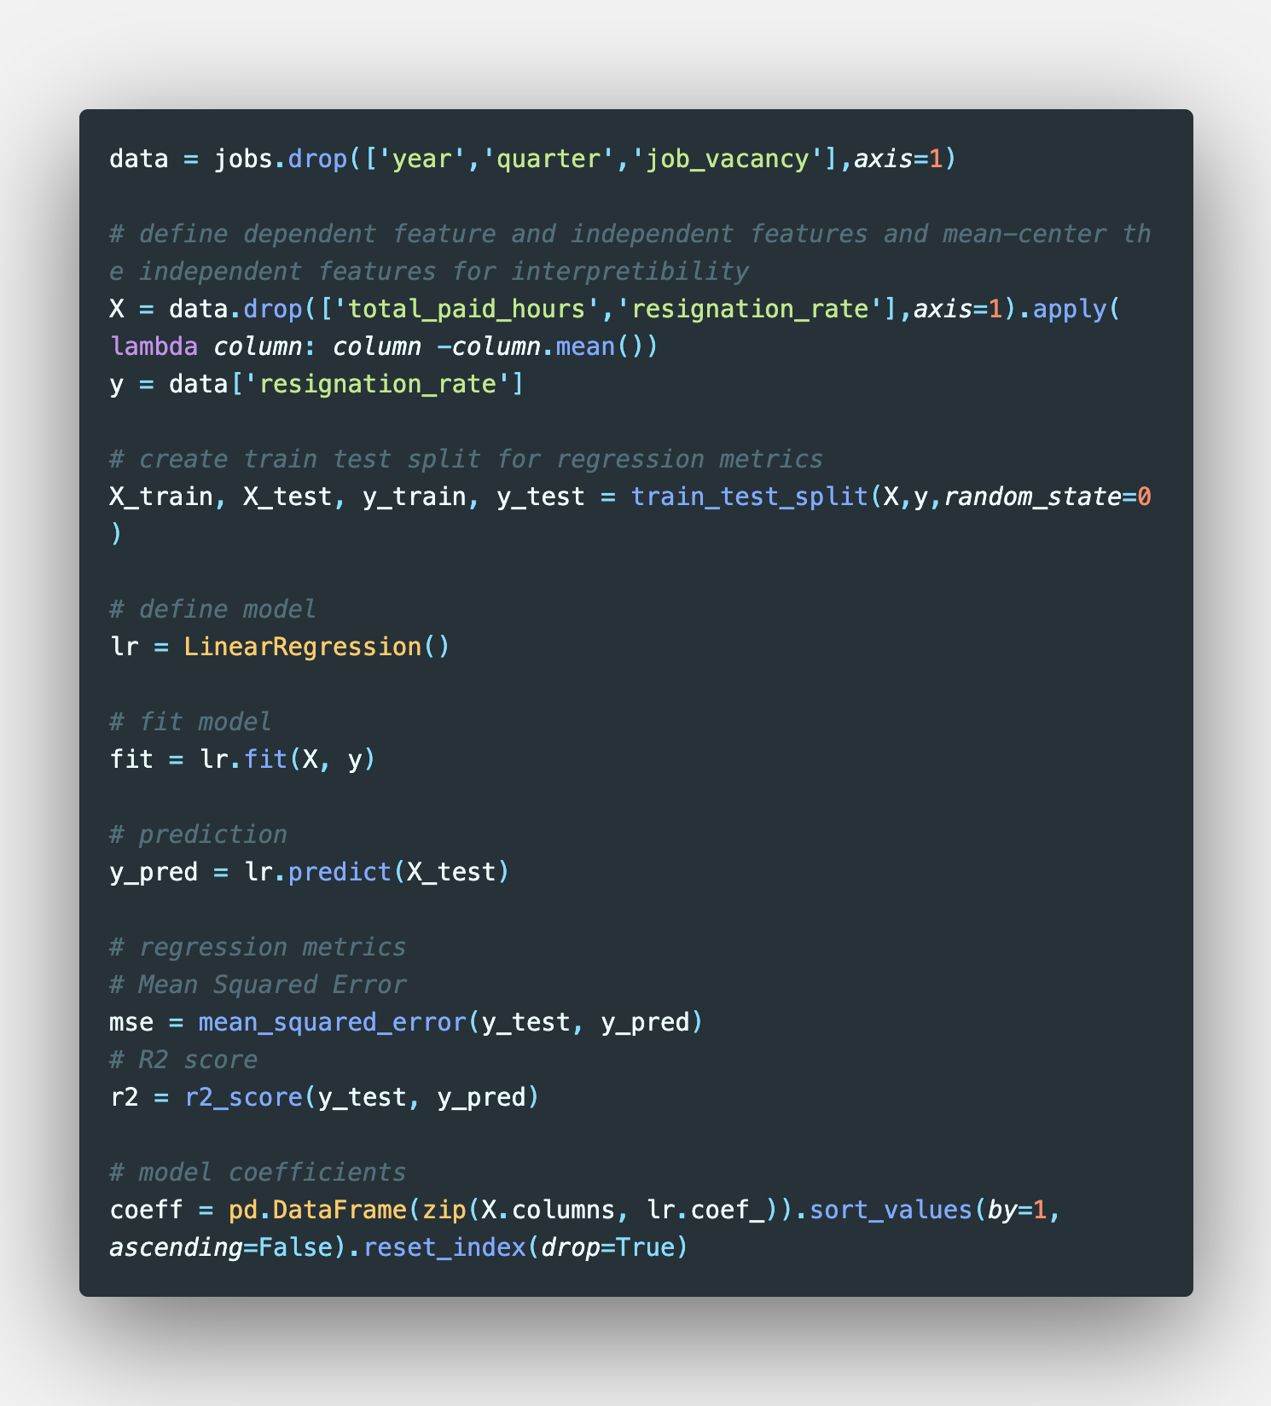
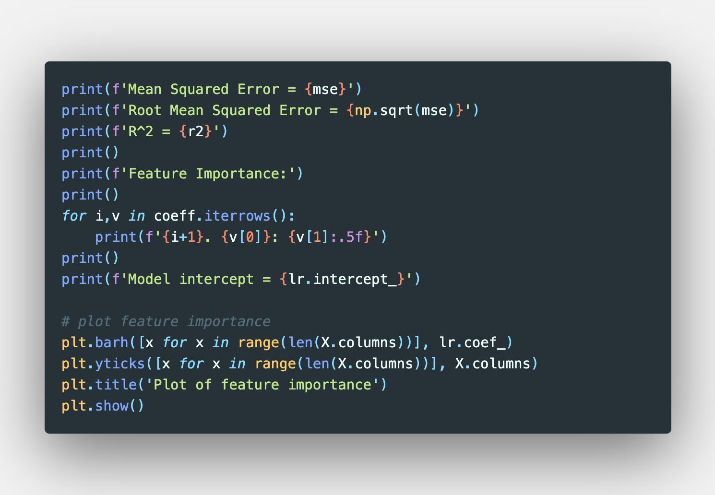
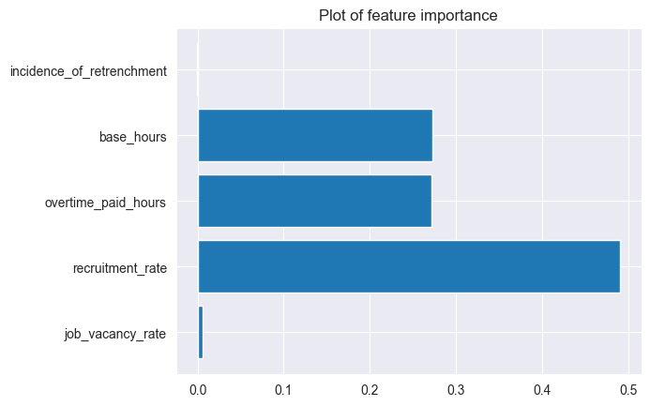
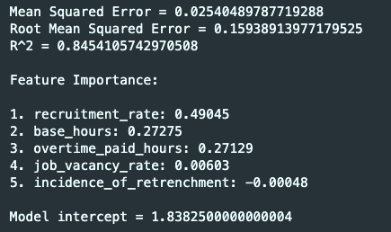
Predicting resignation rates
Features:
Incidence of Retrenchment
Base paid hours
Overtime paid hours
Job Vacancy Rates
Recruitment Rates

Slide 29
Predicting resignation rates

Slide 30
Predicting resignation rates

